Slide 1
diagrams

Slide 2
Software analysis and design includes all activities, which help the transformation of requirement specification into implementation.
Requirement specifications specify all functional and non-functional expectations from the software.
These requirement specifications come in the shape of human readable and understandable documents, to which a computer has nothing to do.

Slide 3
Software analysis and design is the intermediate stage, which helps human-readable requirements to be transformed into actual code.
Let us see few analysis and design tools used by software designers

Slide 4
DATA FLOW DIAGRAM

Slide 5
Data flow diagram is graphical representation of flow of data in an information system.
It is capable of depicting incoming data flow, outgoing data flow and stored data.
The DFD does not mention anything about how data flows through the system

Slide 6
Types of DFD
Logical DFD - This type of DFD concentrates on the system process, and flow of data in the system. For example in a Banking software system, how data is moved between different entities.
Physical DFD - This type of DFD shows how the data flow is actually implemented in the system. It is more specific and close to the implementation.

Slide 7
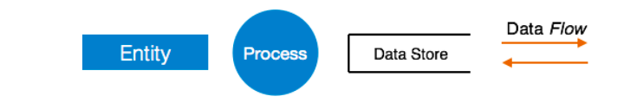
DFD Components
DFD can represent Source, destination, storage and flow of data using the following set of components –

Slide 8
Entities - Entities are source and destination of information data. Entities are represented by a rectangles with their respective names.
Process - Activities and action taken on the data are represented by Circle or Round-edged rectangles.
Data Storage - There are two variants of data storage - it can either be represented as a rectangle with absence of both smaller sides or as an open-sided rectangle with only one side missing.

Slide 9
Data Flow - Movement of data is shown by pointed arrows. Data movement is shown from the base of arrow as its source towards head of the arrow as destination.
Levels of DFD
Level 0
Level 1
Level 2

Slide 10
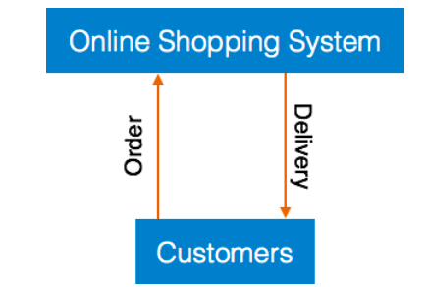
Level 0 - Highest abstraction level DFD is known as Level 0 DFD, which depicts the entire information system as one diagram concealing all the underlying details. Level 0 DFDs are also known as context level DFDs

Slide 11
Level 1 - The Level 0 DFD is broken down into more specific, Level 1 DFD.
Level 1 DFD depicts basic modules in the system and flow of data among various modules.
Level 1 DFD also mentions basic processes and sources of information.

Slide 12
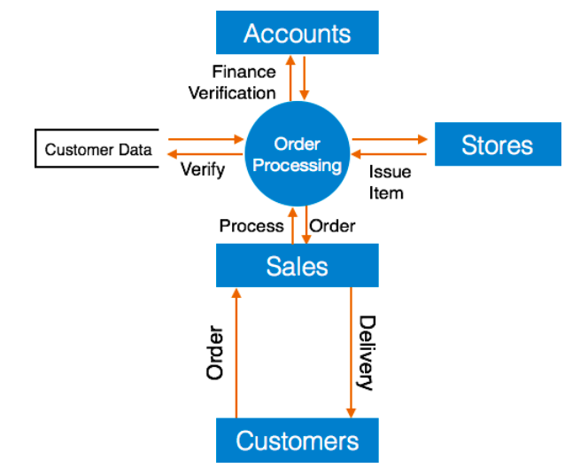

Slide 13
Level 2 - At this level, DFD shows how data flows inside the modules mentioned in Level 1.
Higher level DFDs can be transformed into more specific lower level DFDs with deeper level of understanding unless the desired level of specification is achieved.

Slide 14
Rules and tips for DFD
Each process should have at least one input and an output.
Each data store should have at least one data flow in and one data flow out.
Data stored in a system must go through a process.
All processes in a DFD go to another process or a data store

Slide 15
FLOW CHART

Slide 16
A flowchart is a diagram that depicts a process, system or computer algorithm
They are widely used in multiple fields to document, study, plan, improve and communicate often complex processes in clear, easy-to-understand diagrams.
Flowcharts use rectangles, ovals, diamonds and potentially numerous other shapes to define the type of step, along with connecting arrows to define flow and sequence

Slide 17
When it is used
To develop understanding of how a process is done.
To study a process for improvement.
To communicate to others how a process is done.
When better communication is needed between people involved with the same process.
To document a process.

Slide 18
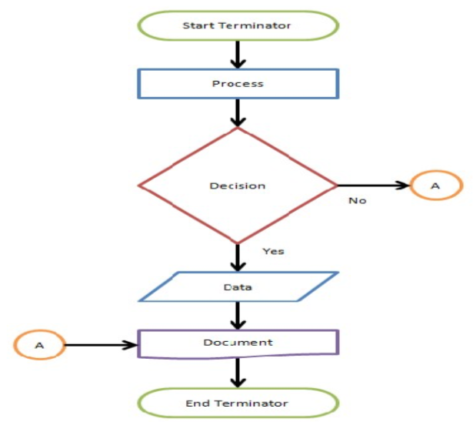
FLOW CHART SYMBOLS

Slide 19
Terminator: An oval flow chart shape indicating the start or end of the process.
Process: A rectangular flow chart shape indicating a normal process flow step.
Decision: A diamond flow chart shape indication a branch in the process flow.

Slide 20
Connector: A small, labeled, circular flow chart shape used to indicate a jump in the process flow. (Shown as the circle with the letter “A”, below.)
Data: A parallelogram that indicates data input or output (I/O) for a process.
Document: Used to indicate a document or report

Slide 21
Object-Oriented Design

Slide 22
In the object-oriented design method, the system is viewed as a collection of objects (i.e., entities)
Objects have their internal data which represent their state.
The different terms related to object design are:

Slide 23
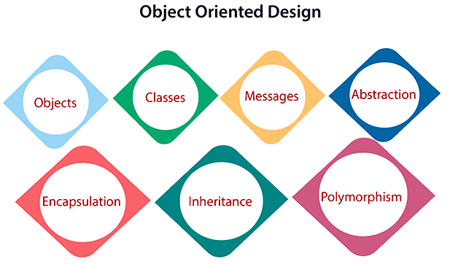

Slide 24
Objects: All entities involved in the solution design are known as objects. For example, person, banks, company, and users are considered as objects. Every entity has some attributes associated with it and has some methods to perform on the attributes.

Slide 25
Classes: A class is a generalized description of an object. An object is an instance of a class. A class defines all the attributes, which an object can have and methods, which represents the functionality of the object.
Messages: Objects communicate by message passing. Messages consist of the integrity of the target object, the name of the requested operation, and any other action needed to perform the function. Messages are often implemented as procedure or function calls.

Slide 26
Abstraction In object-oriented design, complexity is handled using abstraction.
Encapsulation: Encapsulation is also called an information hiding concept. The data and operations are linked to a single unit. Encapsulation not only bundles essential information of an object together but also restricts access to the data and methods from the outside world.

Slide 27
Inheritance: OOD allows similar classes to stack up in a hierarchical manner where the lower or sub-classes can import, implement, and re-use allowed variables and functions from their immediate superclasses. This property of OOD is called an inheritance. This makes it easier to define a specific class and to create generalized classes from specific ones.

Slide 28
Polymorphism: OOD languages provide a mechanism where methods performing similar tasks but vary in arguments, can be assigned the same name. This is known as polymorphism, which allows a single interface is performing functions for different types. Depending upon how the service is invoked, the respective portion of the code gets executed.

